Slide 1
Low-cost Appliance State Sensing for Energy Disaggregation
Tianji Wu
6/16/2012

Slide 2
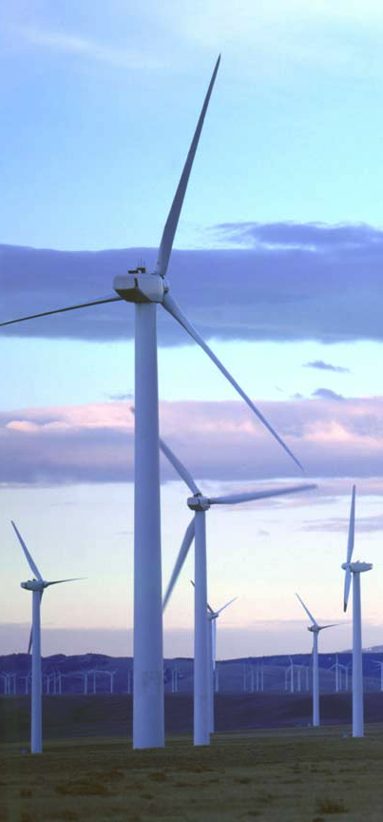
Importance of electrical energy disaggregation
Electricity: the most important energy source
Notes:
41% of total energy consumption in US is consumed to generate elctricity.
Res + commercial use continuously growing for 40 yrs, when other energy form do not grow.
Replacement of fossil fuel are all electrical: nuclear fusion, wind, solar..

Slide 3
Importance of electrical energy disaggregation
Fine-grained energy consumption information is crucial
Notes:
Traditionally, utilities provides only aggregated energy use reports.
Knowing disaggregated consumption info can help optimize usage, and conserve energy.

Slide 4
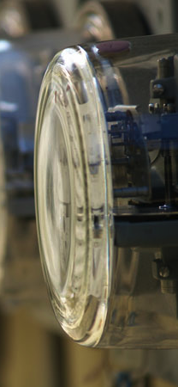
Current disaggregation methods and limitations
Direct-sensing (cost)
Watts up? PRO, Kill-A-Watt
ACme
Non-intrusive (scalability)
Steady-state
Transient signatures
Hybrid
Dumb sensors + central intelligence
Notes:
Watts up are $200, Kill-a-watt $20 but not connectivity
Acme $60, good for experiments, not for real life.

Slide 5
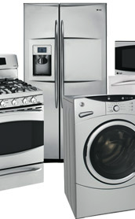
Contributions of this work
Appliance state sensing system
Low-cost
Large-scale
Reliable
Energy disaggregation assisted by the system

Slide 6
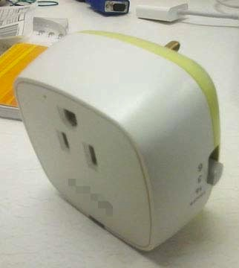
Appliance state sensor node design
Block diagram of the sensor node

Slide 7
Appliance binary state sensor node design - Event detection
Block diagram of the sensor node
Event detection flowchart

Slide 8
Appliance binary state sensor node design - Event detection
Current sensing only
No voltage channel
No metering module
Event detection flowchart

Slide 9
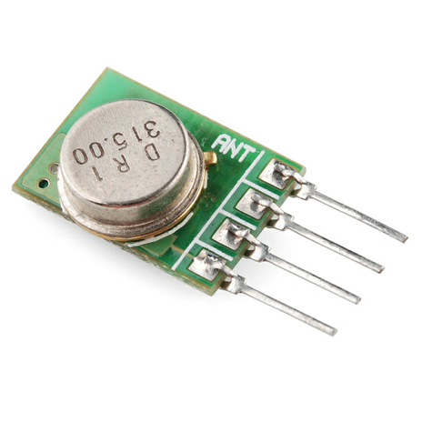
Appliance binary state sensor node design - Simplex radio
1-pin control
Low-cost
TX only
Block diagram of the sensor node

Slide 10
Appliance binary state sensor node design - Cost and scalability
Binary state
Current only
Simpler MCU
No calibration
TX only module
Simpler MCU
Each node cost $4.3
Block diagram of the sensor node

Slide 11

Radio protocol design - Retransmission
Radio is TX-only
No acks, no delivery confirmations
Retransmissions with random backups
Retransmission timeslots: each timeslot is 4 AC cycles long

Slide 12
Radio protocol design - Retransmission
Packet format
Retransmissions with random backups
Retransmission timeslots: each timeslot is 4 AC cycles long

Slide 13
Radio protocol design - How many retransmissions?
Simulation
Packet level, continuous time
Detect collision
Poisson distributed events
μ: expected interval between events on one appliance
EDR: Event delivery rate (%)
PDR: Packet delivery rate (%)
PDR₀: PDR without collision

Slide 14
Radio protocol design - How many retransmissions?
PDR₀=0.4
PDR₀=1

Slide 15
Radio protocol design - How many retransmissions?
PDR₀=0.4
More likely case
Some node has poor link
Sparse events

Slide 16
Radio protocol design - Timeslot alignment
4-cycle alignment: improves EDR/PDR @ short μ
1-cycle alignment: slightly better then totally async

Slide 17
Radio protocol design - Tow-event collision
Testbed
6 sensor nodes
Programmatically external controlled events
Two-event collision
Two events at a time
0s ~ 0.4s interval

Slide 18
Radio protocol design - Poisson distributed events
Testbed
6 sensor nodes
Programmatically external controlled events
Poisson distributed

Slide 19
Radio protocol design - In real settings
PDR and EDR in real settings: 18 days of data

Slide 20
Assisted energy disaggregation
Block diagram of energy disaggregation algorithm

Slide 21
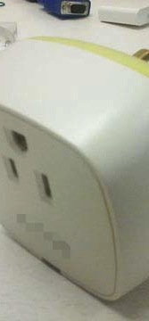
Assisted energy disaggregation - Experimental setup
20 nodes deployed
9 LCD monitors
8 Laptops
1 solder station
1 workbench light
1 water dispenser
13 nodes are instrumented with Watts up? PRO meter for ground truth
2s interval
Data collected with Gumstix and logged in database
Aggregated power reading from E30A panel meter
2s interval
Actually sum of 4 circuits

Slide 22
Assisted energy disaggregation - Piecewise constant denoise
Detect step changes in noisy signal
Online jump penalization
Use least step changes to get best estimation of the signal

Slide 23
Assisted energy disaggregation - Appliance state tracking
Appliance state tracking accuracy: threshold=5W

Slide 24
Assisted energy disaggregation - Estimated energy consumption
Disaggregated energy consumption

Slide 25
Assisted energy disaggregation - Estimated energy consumption

Slide 26
Assisted energy disaggregation - Estimated energy consumption

Slide 27
Assisted energy disaggregation - Estimated energy consumption

Slide 28
Conclusion
Accurate state sensing with low-cost sensors
99.5% state tracking accuracy
Easily scale to tens of appliances
Assisted energy disaggregation
Mostly 70% accuracy
Laptops are hard: large variation in power

